Slide 1
N-TIER ARCHITECTURE
BY ADEEB.

Slide 2
FIRST KNOW ABOUT BASIC THINGS:
WHAT IS A TIER
WHAT IS A LAYER
WHAT ARE THE LAYERS WILL PRESENT IN OUR
APLLICATION

Slide 3
WHAT IS A TIER:
Tier means physical deployment computer (or)physically presented
A single server is a one Tier
Example : our computer is one tier

Slide 4
What is a layer
layer means logic software component group mainly by functionality
layer is used for software development purpose
Ex: Application layer(AL)
Business Logic layer(Bll)
Data acess layer(DAL)

Slide 5
NOW QUESTION IS:
WHAT IS THIS APPLICATION LAYER
WHAT IS THIS BUSSINESS LAYER
WHAT IS THIS DATA ACCESS LAYER

Slide 6
WHAT IS APPLICATION LAYER
A Application layer that users can access directly, such as desktop UI, web page and etc.
A layer which contains some controls like buttons,textboxes etc.
A layer where user can apply (or ) give something (or) present something

Slide 7
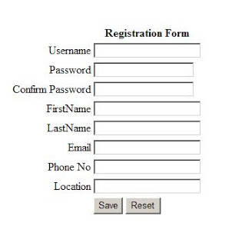
Example for Application layer(AL):
Now in above,A user can enter some data.If The application wants to perform the operation (or)funtionality.then there should be some logic (or) some code.

Slide 8
WHAT IS BUSINESS LOGIC LAYER(BLL)
Writing the code (or) logic (or) program in one layer is Know as Business logic layer
In Bll,we write the code in the form of classes
In Bll,different classes are present to perform different operation for our Application layer(AL)
A Bll is mediator between AL and DAl.

Slide 9
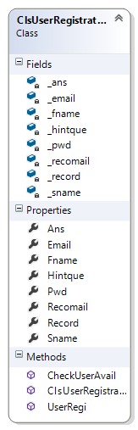
DIAGRAMITICAL REPRESENTATION OF CLASS(BLL)

Slide 10
Now what the data we entered in “Application layer “is performed the operation by “Business logic layer”.
In BLL, we have Classes,in Classes we have Methods to perform the operations
For Ex : see above class diagram.we have CLASS REGISTRATION
In Class, we have method like ClsUserRegistration()
Now these data has to be store in the Database know.

Slide 11
WHAT IS DATA ACCESS LAYER:
The layer which is used to set the data into database and to get the data from database is know as DataAcessLayer(DAL)
Data Access Layer contains classes to connect with database and to perform insert,update,delete operations and to get data from database based on our input data.
IN Data Access Layer, we have classes, in classes we have methods like Execute Non-Query, Execute Scalar, Execute Reader.

Slide 12
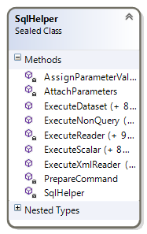
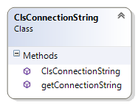
DIAGRAMATTICAL REPRESENTATION OF CLASS(DAL):

Slide 13
1. Connection string (class):
Connection string is a class which have two methods usefull to establish the connection and to get the connection
Methods : 1.clsconnectionString()-to establish the connection
2.getconnectionString()-to get connection

Slide 14
2.SQLHELPER (Class)
Sql Helper is the class which is usefull to perform the operations like Insert,Update,Delete and Select operations called as DML Operations
To perform DML Operations SqlHelper Class Contains Some Methods like 1.ExecuteNonQuery()
2.ExecuteScalar()
3.ExecuteReader()
4.ExecuteDataSet()

Slide 15
METHODS IN DATA ACCESS LAYER:
Execute Non-Query For To perform Insert,update,delete operations
Execute Scalar is for Select operation in the form of Rows & Columns
Execute Reader is for Select operation in the form of particular Row

Slide 16
NOTE
APPLICATION LAYER : WHERE YOU GIVE SOMETHING (or) PRESENT SOMETHING
BUSINESS LOGIC LAYER:WHERE WE WRITE A LOGICAL CODE FOR THE PERFORMANCE OF APPLICATION LAYER
DATAACCESS LAYER : WHERE WE WRITE CODE TO STORE OUR DATA (or) TO GET THE DATA FROM DATABASE

Slide 17
NOW QUESTION IS:
WHERE THESE LAYERS WILL PRESENT?
DEPENDING UPON WHERE THESE LAYERS ARE PRESENTS SAYS WHAT TYPE OF ARCHITECTURE IT IS.

Slide 18
APPLICATION LAYER BUSINESSlAYER DATALAYER

Slide 19
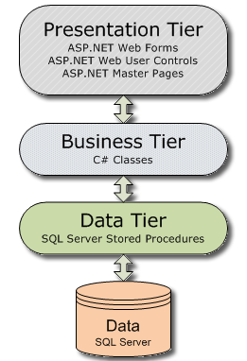
DIAGRAMATICAL REPRESENTATION OF LA ERS

Slide 20
ONE TIER ARCHITECTURE:
If all these three layers (i,e) Al,BLL,DAl with DataBase will present in one place (or)in one system(or) In one Server.Then It is called as One Tier Architecture(or) Single Tier Architecture.
Single Tier Architecture Means All layers will Present In One P.C .
AL+BAL+DAL+DATABASE = ONE SERVER
We can also say If AL,BAL,DAL code will written in single layer then it is called as one tier Arcitecture

Slide 21
TWO TIER ARCHITECTURE:
If AL,BLL,DAL will present In one system And our DataBase will present in Another System Then it is called Two Tier Arcitecture
AL + BAL +DAL = ONE SERVER (or) ONE P.C
DATEBASE = ANOTHER P.C (or) IN ONE SERVER
We can also say if AL will in one layer.BAL,DAL code will in Another layer then it is called as Two Tier Arcitecture

Slide 22
3 TIER (or) N TIER ARCITECTURE:
If all the Layers are in Different servers likeA.L in one server,BLL in one server,DAL in one server And Our DataBase is in Some other server Then It is called as N Tier Arcitecture
AL = one server
Bal = one server
DAL = one server
DATABASE = one server
We can also say AL Layer will in One layer, BLL code in one layer, Dal code in another layer then it is called as N Tier Arcitecture

Slide 23
ANY QUERIES ?
EMAI ID : ATIFYAH@GMAIL.COM
CONTACT NO : 9703287632

Slide 24
FEEDBACK PLEASE
If any mistakes are in this,If you know good information
more than this, please send me your reply for my pleasure
and for others pleasure.I can rectify my mistakes and I can
modify it with your suggestions then it will become helpful and valuable to other and for us.

Slide 25


